Slide 1
AWS In A Nutshell

Slide 2
AWS study content
Resources for study :
AWS Training (aws.amazon.com/training)
AWS Business Professional (Digital) AWS TCO and Cloud Economics (Digital)
AWS Cloud Practitioner Essentials (Digital)
Whitepapers of AWS
Overview of Amazon Web Services Architecting for the Cloud: AWS Best Practices How AWS Pricing Works
Cost Management in the AWS Cloud
AWS support plan comparision

Slide 3


Agenda
AWS Cloud & Core Services
Module 1: Understanding AWS Cloud
Module 2: AWS Cloud Infrastructure & Services Module 3 : Core Services
Module 4: Security and Compliance
Module 5: Management & Operation
Module 6: Pricing Solutions and TCO on AWS
Q&A Session
Module 7 : Conclusion

Slide 4
Module 1: Understanding AWS Cloud

Slide 5


Customer Obsession
AWS Leadership Principles
Customer Obsession Learn and Be Curious Earn Trust
Dive Deep
Invent and Simplify Think Big
Bias For Action Drive Results
You
Customer Success
We Do Things in Peculiar Ways

Slide 6




Advantages of Moving to AWS Cloud
Agility
Trade Capital Expense
for Variable Expense
Reduce Expenses
Elasticity
Accelerate Time to Business Value
Increase Innovation
Scale Globally

Slide 7


Patterns We’re Seeing with AWS Customers
Consulting
Partners
Customers
01
02
03
04
Dev & Test Development and test environments
Production Build production apps Migrate production apps
Marketing
Mission Critical Build mission-critical apps Migrate mission-critical apps
All-in
Corporate standard: Cloud First!

Slide 8
Module 2:
AWS Cloud Infrastructure & Services

Slide 9





What Sets AWS Apart?
Enterprise Leadership
Service Breadth and Depth
Pace of Innovation
Global Presence
Building and managing the cloud since 2006
Over 160 services
2238 features in
3 years
60 Availability Zones in 20 geographic regions around the world
Amazon Culture
Security
Largest Partner Ecosystem
Hybrid Cloud
72 proactive price reductions
#1 Priority
AWS Marketplace and APN
Broadest set of hybrid capabilities of any cloud provider

Slide 10

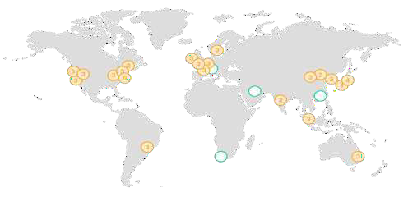
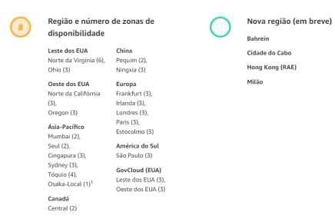






AWS Highly Available Global Infrastructure
20
Geographic Regions
60
Availability Zones
160
Edge Locations
Region
Interconnected using high-speed private links
AWS Availability Zone (AZ)
AZ
AZ
Independent failure zone

Slide 11
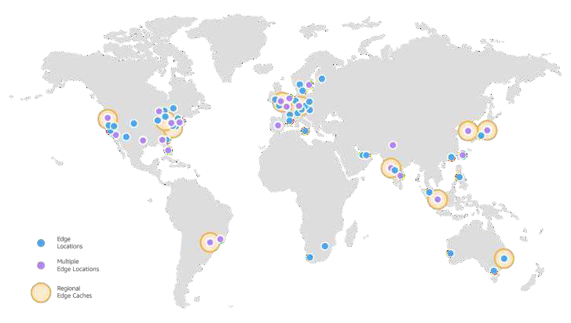
Amazon CloudFront
Content Delivery Network (CDN)
Content close to users = less latency
Static content (web pages, texts, images, movies)
Edge Location = Point of presence where the content cache is performed.

Slide 12
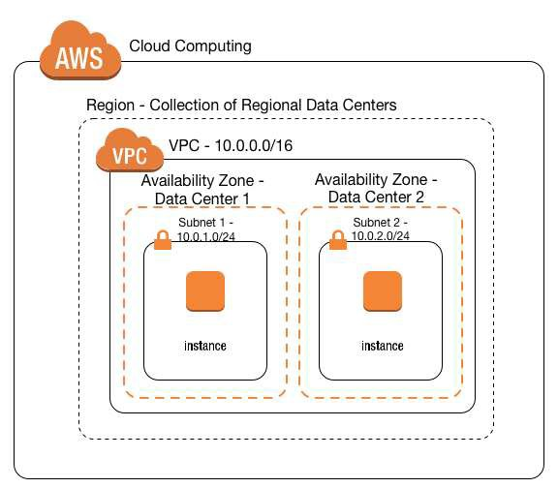

AWS Cloud Hierarchy
Global Services
> Regional > VPC > AZ > Host
Know the service scope:
Route 53 – DNS CloudFront
Regional
Buckets S3
AMI Images
Instances EC2/RDS Volumes EBS Conteiners
AZ
Host
Host applications
Anti-virus, Licenses

Slide 13







AWS Platform Services: Over 120 Services
Over 120 Services
Advanced Services
Analytics
Artificial Intelligence
Mobile
Internet of Things
Game Development
AWS
Marketplace
Business Process Services
Developer Tools
Management Tools
Business Productivity
Application Services
Desktop and App Streaming
Technical and Business Support
Foundational
Services
Compute
Storage
Databases
Networking and Content Delivery
Hybrid Cloud Architecture
Messaging

Slide 14
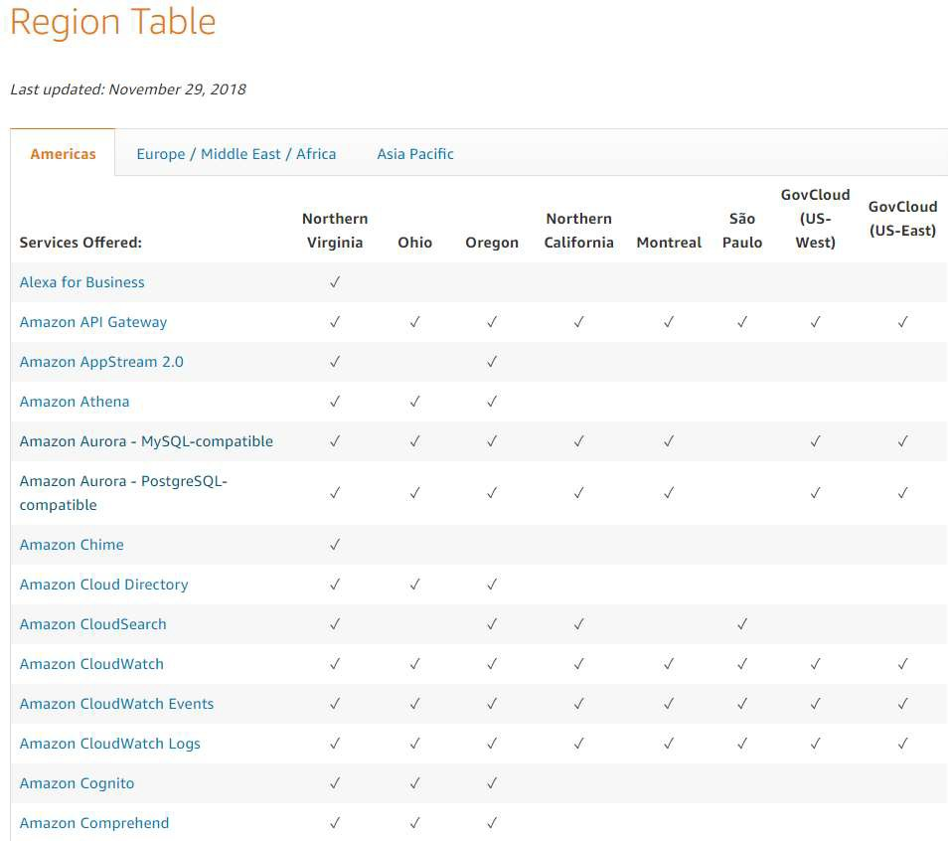
Services Availability per Region
https://aws.amazon.com/about-aws/global-infrastructure/regional-product-services/
Take into account the availability of services in each
region.
Service values vary by region.

Slide 15
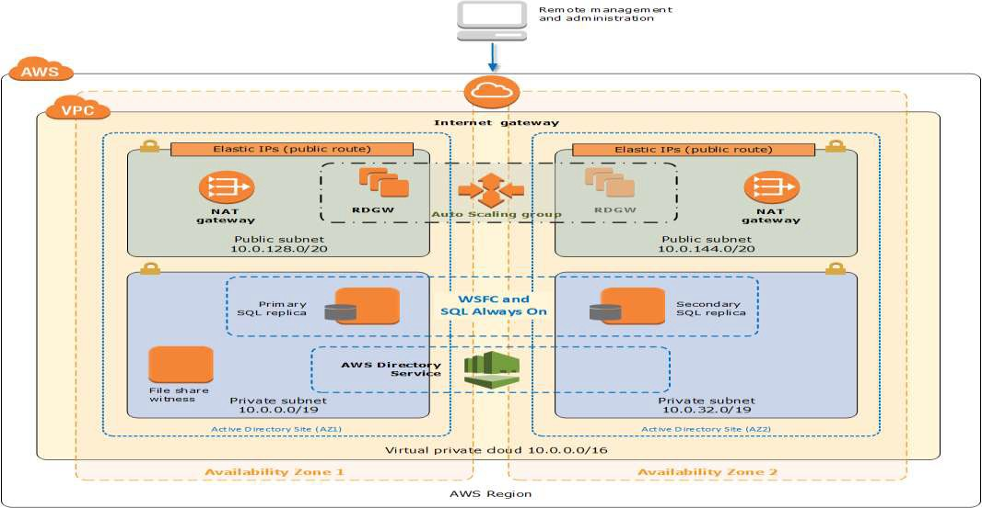
AWS Architectures – SQL Server
Remember the scope of services

Slide 16
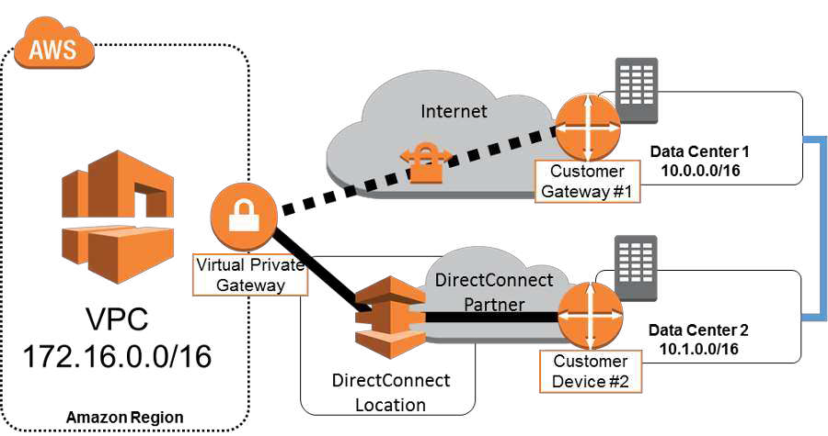
Hybrid Architectures
Hybrid architectures can be implemented in several ways:
VPN
Direct Connect
Vmware on AWS* (depends on the solutions above)
What matters is to establish a transparent connection between client DC and AWS.

Slide 17
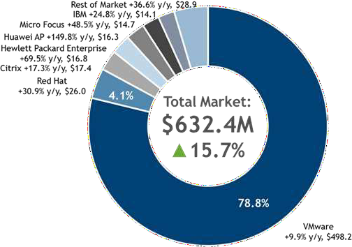
AWS Hybrid Architecture Support
79%
of existing Enterprise workloads run on VMware*
Almost every AWS customer with on-premises infrastructure is running a hybrid architecture.
01.
AWS offers seamless integration with existing on- premises data centers - customers can leverage existing investments
02.
03.
Easily run on VMWare workloads on AWS with seamless deployment and management
AWS offers the only VMWare-delivered, sold and
supported service available on a leading public cloud
04.
* IDC Worldwide Cloud System Software 2015 Share Snapshot

Slide 18
Shared Responsibility Model
https://aws.amazon.com/pt/compliance/shared-responsibility-model/
Customer Data
Platform, Applications, Identity and Access Management
Customer
Responsible For Security “IN” The Cloud
Operating System, Network, and Firewall Configuration
Client-Side Data Encryption and Data Integrity Authentication
Server-Side Encryption (File System and Data)
Storage Database
Network Traffic Protection (Encryption/Integrity/Identity)
Compute
Networking
AWS
Responsible For Security “OF” The Cloud
Regions
AWS Global Infrastructure
Edge Locations
Availability Zones

Slide 19

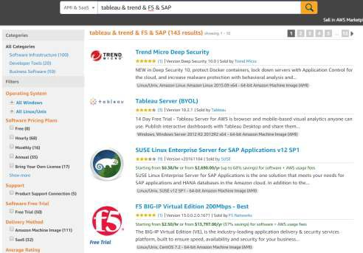
AWS Marketplace Overview
AWS Marketplace is an online store that supports:
01
Over 1,280 participating ISVs
135,000+ active customers
4,200+ software listings
Over 481M hours of software per month

Slide 20
Module 3 : Core Services

Slide 21






















AWS Core Services
Compute
Storage
Networking
Databases
Security
Management
Amazon EC2
Auto Scaling
 | Amazon EBS | Elastic Load | Amazon | Amazon | Amazon | IAM | AWS WAF | Amazon | AWS
Amazon |  | Balancing* | Route 53 | RDS | Aurora |  |  | CloudWatch | CloudTrail
S3
AWS
Lambda
Amazon Glacier
Amazon VPC*
Amazon DynamoDB
AWS KMS
AWS Shield
AWS
CloudFormation
AWS
Config
AWS Direct Connect
VPN
connection
Amazon EC2 Systems Manager

Slide 22
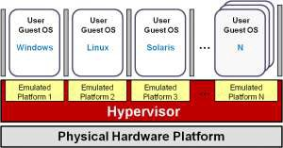
Amazon EC2
Virtual machine instance.
Linux and Microsoft Windows AMI’s.
Amazon Machine Image: is the image of the Operating System that will be loaded in the instance.
Client has full control of the Operating System and its applications as admin.
Multiple types and sizes of instances. Remote access via SSH or Remote Desktop.
Window Svr
https://aws.amazon.com/ec2/

Slide 23



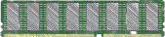






Amazon EC2 - Instance Types
General purpose
Compute optimized
Storage and I/O optimized
GPU
enabled
Memory optimized
M5d
C5d
D2
P3
X1 & X1e
H1
I3
R5 & R5d
M5
t3
P2
C5
G2
z1d
M4
t2
C4
F1
R4
Burst CPU

Slide 24



Amazon EC2 - Purchasing Options
On-Demand
Pay for compute capacity by the second with no long-term commitments
Reserved
Make a 1 or 3 Year commitment and receive a significant discount off On-Demand prices
Spot
Spare EC2 capacity at savings of up to 90% off On-Demand prices
Spiky workloads, to define needs
Committed, steady-state usage
Fault-tolerant, dev/test, time- flexible, stateless workloads
https://aws.amazon.com/pt/ec2/pricing/

Slide 25
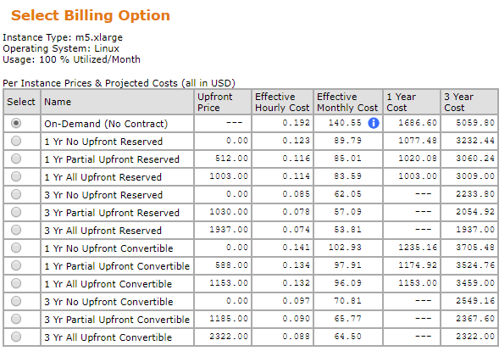
Billing Comparison
N.Virginia, 30th May2022.
Reserved
Convertible

Slide 26




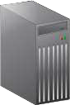

Amazon EC2 –Remote Access
At the moment of creation of the instance it is defined which key-pair will be used to access the instance.
“A key pair consists of a public key that AWS stores, and AWS
a private key file that you store.”
SSH – Command Line
TCP port 22
Private Key
Public Key
Administrator
RDP – Remote Desktop
TCP port 3389

Slide 27




EC2 Auto Scaling
Horizontal growth of instances
Provision and Deprovision
CPU utilization triggers the alarm: capacity is doubled until
CPU utilization drops below 60% or max capacity is reached.
Ensures High Availability
Reduced costs. Supply = Consumption
Minimum = 2, Maximum = 12
Growth policies
CPU, Memory, Volumes, etc..
Auto Scaling group
Availability Zone 1
Availability Zone 2

Slide 28

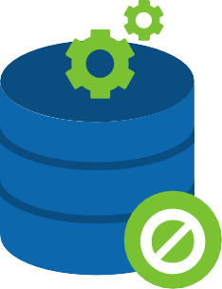

AWS Lambda: Serverless Compute
Transform applications into EC2 instances into serverless applications.
No servers to manage
Pay only for compute time used
Pay only for compute time used
AWS Lambda Video
https://www.youtube.com/watch?v=eOBq h4OJ4 (3:01)

Slide 29






AWS Core Services
Compute
Storage
Networking
Databases
Security
Management
Amazon EC2
Auto Scaling
Amazon EBS
Elastic Load Balancing*
Amazon Route 53
Amazon RDS
Amazon Aurora
IAM
AWS WAF
Amazon CloudWatch
AWS
CloudTrail
Amazon S3
AWS
Lambda
Amazon Glacier
Amazon VPC*
Amazon DynamoDB
AWS KMS
AWS Shield
AWS
CloudFormation
AWS
Config
AWS Direct Connect
VPN
connection
Amazon EC2 Systems Manager

Slide 30



Amazon EBS – Elastic Block Storage
Volumes associated with EC2 instances.
EC2 instance
Persistent Data
You can shut down, restart, terminate the instance.
Decouple the instance volume.
Volumes of 1GB a 16TB.
EBS
Volume
EBS
Volume
SSD or HDD.
Support encryption.
C:/...
C:/Windows/...
D:/

Slide 31






Amazon S3 – Simple Storage Service
99.999999999% durability and 99.99% availability of objects over a given year
AZ_1
Storage of any type of file (objects).
There is no limit on the number of objects or total space.
AZ_2
Regionl: Sao_Paulo
bucket: covenantS3bucket
…
AZ_3

Slide 32


Amazon S3 Glacier
99.999999999% durability of objects over a given year
Long term archiving, backup
Low cost.
Data are extracted by executing retrieval jobs.
Ready to download!
Object ID 001
Object ID 025
Object ID 150
Object ID 400
….
ID 001
ID 025
ID 150
Archive retrieval job
Expedited: 1~5min
Standard: 3~5hs
Bulk: 5~12hs
ID 400

Slide 33



AWS Core Services
Compute
Storage
Networking
Databases
Security
Management
Amazon EC2
Auto Scaling
Amazon EBS
Elastic Load Balancing*
Amazon Route 53
Amazon RDS
Amazon Aurora
IAM
AWS WAF
Amazon CloudWatch
AWS
CloudTrail
Amazon S3
AWS
Lambda
Amazon Glacier
Amazon VPC*
Amazon DynamoDB
AWS KMS
AWS Shield
AWS
CloudFormation
AWS
Config
AWS Direct Connect
VPN
connection
Amazon EC2 Systems Manager

Slide 34

Amazon Route 53
DNS Service
Name resolution: www.netflix.com to 200.x.x.x.
www.covenant.ca-cib.com
Public IP: 200.1.1.1
Route 53
AWS
Who is www.covenant.cagip.com?
200.1.1.1
www.covenant.ca-cib.com

Slide 35
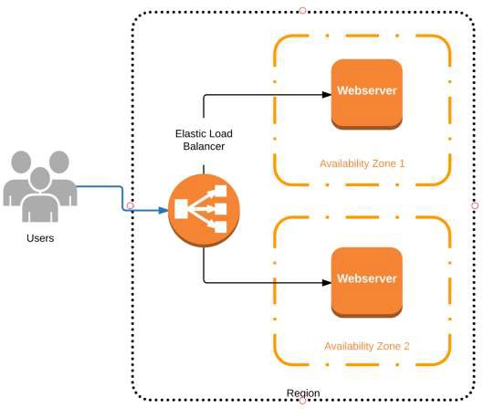
Amazon Elastic Load Balancer
Balancing connections for different servers.
Ensures high service availability.
Usually used in conjunction with EC2 Auto Scaling.

Slide 36




VPC – Virtual Private Cloud
Internet
192.168.0.0/16
AZ_1
AZ_2
Amazon VPC
192.168.1.5/24
192.168.1.6/24
192.168.2.5/24
192.168.2.6/24
Provision a logically isolated section of the AWS cloud
Control your virtual networking environment
Networking
Security
Connect to your on-premises network via VPN or Direct Connect
Control if and how your instances access the Internet

Slide 37
Hybrid Architectures
Arquiteturas híbridas podem ser executadas de diversas formas:
VPN
Direct Connect
Vmware on AWS* (depende das soluções acima)
O que importa é estabelecer uma conexão transparente entre DC do cliente e AWS.

Slide 38


AWS Core Services
Compute
Storage
Networking
Databases
Security
Management
Amazon EC2
Auto Scaling
Amazon EBS
Elastic Load Balancing*
Amazon Route 53
Amazon RDS
Amazon Aurora
IAM
AWS WAF
Amazon CloudWatch
AWS
CloudTrail
Amazon S3
AWS
Lambda
Amazon Glacier
Amazon VPC*
Amazon DynamoDB
AWS KMS
AWS Shield
AWS
CloudFormation
AWS
Config
AWS Direct Connect
VPN
connection
Amazon EC2 Systems Manager

Slide 39




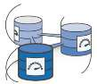

Amazon RDS – Relational Database Service
Relational Databases
Self Managed Service
Automation of routines
Secure, scalable, simple to use
Low cost, pay per use
Amazon Aurora
Amazon RDS

Slide 40
Amazon RDS – Relational Database Service
Important points:
Easiness for the client to maintain a relational database.
Very used in the process of developing new applications.
Automatic update, backup, synchronization and redundancy routines.

Slide 41
Module 4: Security and Compliance

Slide 42
AWS Core Services
Compute
Storage
Networking
Databases
Security
Management
Amazon EC2
Auto Scaling
Amazon EBS
Elastic Load Balancing*
Amazon Route 53
Amazon RDS
Amazon Aurora
IAM
AWS WAF
Amazon CloudWatch
AWS
CloudTrail
Amazon S3
AWS
Lambda
Amazon Glacier
Amazon VPC*
Amazon DynamoDB
AWS KMS
AWS Shield
AWS
CloudFormation
AWS
Config
AWS Direct Connect
VPN
connection
Amazon EC2 Systems Manager

Slide 43




Security Is Our #1 Priority
Compliance and Security at Scale on a Single Platform
Highly Automated
Highly Available
Highly Accredited
24/7

Slide 44





Self Served and Managed Services
Amazon EC2
Service
Fully Managed Service
Self-Managed
Database
DB on EC2
instance
RDS
Corporate data center
AWS Data Center(s)
AWS Data Center(s)

Slide 45
Shared Responsibility Model
https://aws.amazon.com/pt/compliance/shared-responsibility-model/
Customer Data
Platform, Applications, Identity and Access Management
Customer
Responsible For Security “IN” The Cloud
Operating System, Network, and Firewall Configuration
Client-Side Data Encryption and Data Integrity Authentication
Server-Side Encryption (File System and Data)
Storage Database
Network Traffic Protection (Encryption/Integrity/Identity)
Compute
Networking
AWS
Responsible For Security “OF” The Cloud
Regions
AWS Global Infrastructure
Edge Locations
Availability Zones

Slide 46



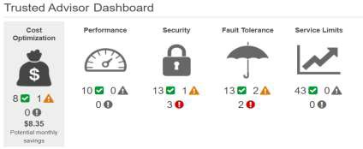
AWS Built-In Security
AWS Platform Security
AWS Service-Specific Security
Security Focus | Security Services and Features
Infrastructure Security | Amazon VPC AWS WAF Encryption in-transit with TLS with all services Connectivity options to enable private or dedicated connections from your office or on-premises environment
Identity and Access Control | AWS Identity and Access Management (IAM) AWS Multi-Factor Authentication AWS Directory Service
Monitoring and Logging | AWS Trusted Advisor AWS CloudTrail Amazon CloudWatch Amazon Macie
Inventory and Configuration | Amazon Inspector AWS Config AWS CloudFormation
DDoS Mitigation | AWS Shield - Auto Scaling Amazon CloudFront Amazon Route 53
Data Encryption | Encryption with all AWS storage and database services Flexible Key Management options AWS KMS AWS CloudHSM
Host
Platform
AWS Trusted Advisor
77

Slide 47



Service Specific Security
Guest OS+Top App. Service Security
Firewall rules (sec.group, NACL)
AWS builds security into every layer of the AWS infrastructure and also into each of the services available on the infrastructure.
Administrative Security - IAM
Host OS , Virtualization Security
EC2 instance
DC Physical Infrastructure Security
…
RDS
Application Load
Balancer
Amazon S3
Amazon DynamoDB

Slide 48









Platform Security Services
AWS also builds security-specific services directly into the platform.
Need to know services for the exam:
IAM
AWS Shield
AWS WAF
AWS Artifact
Amazon Directory Services
Amazon CloudWatch
AWS
CloudTrail
AWS
Config
MFA token
AWS
CloudFormation

Slide 49






AWS IAM – Identity & Access Management
Prime security service!
Defines administrative profiles.
Who can do what on the AWS console or by the additional management tools.
You can enable Multi Factor Authentication (MFA) to login.
Provides interaction permission between services.
SupportUser
"Action": [
"support:*", "acm:DescribeCertificate", "acm:GetCertificate", "acm:List*", "apigateway:GET", "appstream:Get*", "autoscaling:Describe*",
"aws-marketplace:ViewSubscriptions", "cloudformation:Describe*",
...

Slide 50



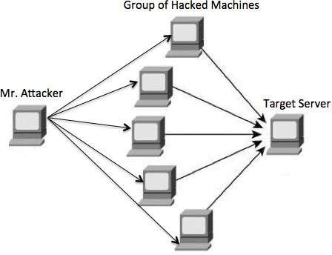


AWS Shield Standard and AWS Shield Advanced
DDoS : Distributed Denial of Service. Botnets, massive attacks
Provides DDoS protection service that safeguards your customers’ web applications running on AWS.
Always-on Detection
Defend against common attacks
No Cost for
Standard

Slide 51





AWS Web Application Firewall
Protection for websites such as e-commerce, blogs, sites with forms, sites with registers (DB's).
Works over CloudFront or Application Load Balancer.
You create permission / deny access rules.
AWS WAF helps protect your web applications from common web exploits that could affect application availability, compromise security, or consume excessive resources.
Internet
web app server
attacker
Availability Zone #1
Balanceador
web app server
Availability Zone #2
AWS cloud

Slide 52





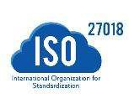










On-Demand Access to Compliance Reports
Download Compliance Reports on Demand
AWS Artifact
On-demand access to print AWS security and compliance
reports.

Slide 53
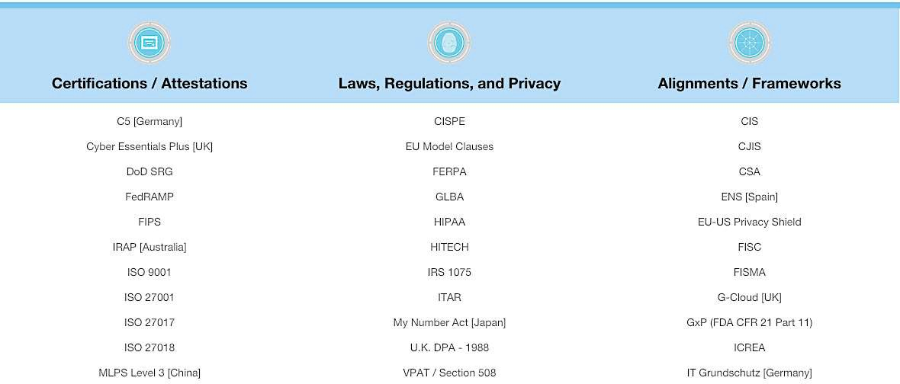
AWS Assurance Programs: 58+ Certifications
https://aws.amazon.com/compliance/

Slide 54
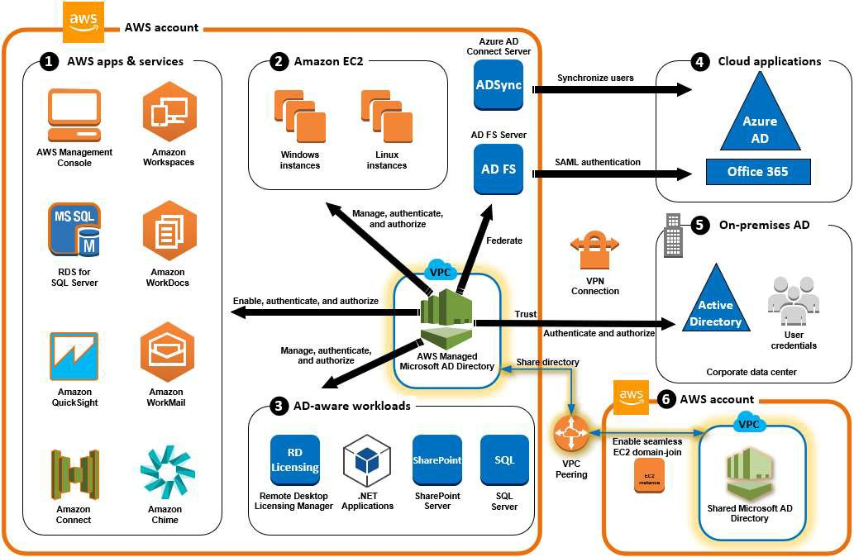
AWS Directory Service
Security, identity and compliance - User management
1: Sign In to AWS Applications and Services with AD Credentials
2: Manage Amazon EC2 Instances
3: Provide Directory Services to Your AD-Aware Workloads
4: SSO to Office 365 and Other Cloud Applications
5: Extend Your On-Premises AD to the AWS Cloud
6: Share Your Directory to Seamlessly Join Amazon EC2 Instances to a Domain Across AWS Accounts

Slide 55
Module 5: Management & Operation

Slide 56
AWS Core Services
Compute
Storage
Networking
Databases
Security
Management
Amazon EC2
Auto Scaling
Amazon EBS
Elastic Load Balancing*
Amazon Route 53
Amazon RDS
Amazon Aurora
IAM
AWS WAF
Amazon CloudWatch
AWS
CloudTrail
Amazon S3
AWS
Lambda
Amazon Glacier
Amazon VPC*
Amazon DynamoDB
AWS KMS
AWS Shield
AWS
CloudFormation
AWS
Config
AWS Direct Connect
VPN
connection
Amazon EC2 Systems Manager

Slide 57

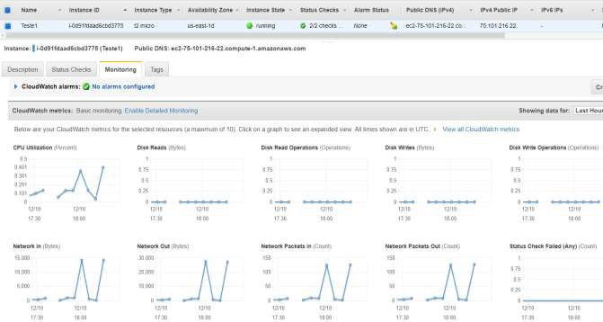
AWS CloudWatch
Provides operational visibility.
Monitoring and Alarm Service.
Dashboard of consumptions reading.
Can be used for Cost Management.
Integrated with various AWS services.

Slide 58



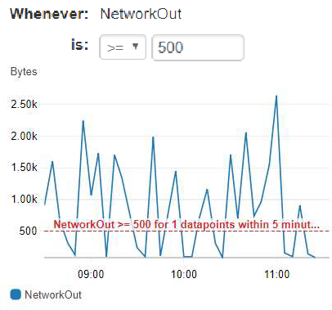
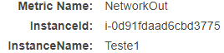






AWS CloudWatch - Alarms
Define Metric
Who
Define Triggers
When
Define Notifications
Warn/Perform…
1. SNS Notification
2. Autoscaling Action
web app server
( 3. EC2 Action )*
*only if Metric=EC2
EC2 Instance

Slide 59



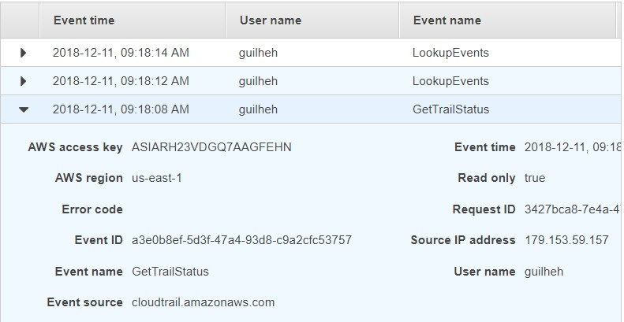
AWS CloudTrail
Who did that?!
CloudTrail provides the event history of AWS account activity.
Permits governance, compliance, audit.
Logs API calls.
Security analysis.
Tracking of resource changes.
Problems solution.

Slide 60
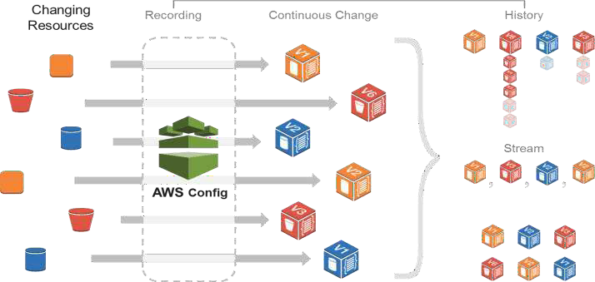
AWS Config
Monitor and record change logs in your AWS resource settings.
Resources Inventory.
'Out of standard' changes triggers SNS notifications.
AWS Config
Amazon EC2
Amazon EBS
Amazon
VPC
AWS
CloudTrail

Slide 61

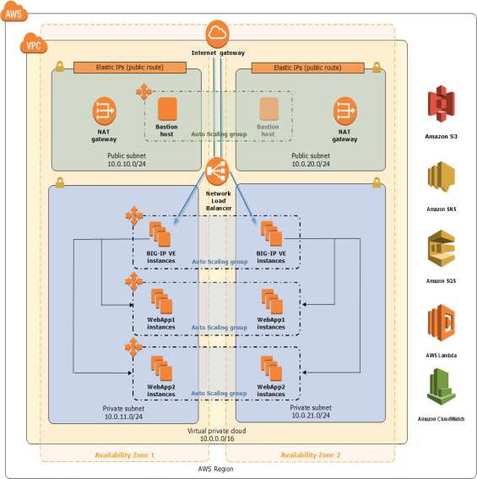
AWS CloudFormation
Repetitive provisioning, safe, known.
Application/usage of best practices.
Ease, speed.
…
…
"DBName": {
"Default": "MyDatabase",
"Description": "MySQL database name", "Type": "String",
"MinLength": "1",
"MaxLength": "64",
....

Slide 62
Module 6: Migrations

Slide 63
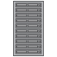
Business Drivers for Cloud Adoption
Cost
Agility
Significant Business- Impacting Event
New regulations
Upgrade hardware
Freedom to Experiment
Faster Development

Slide 64






Cloud Migration: A Phase-Driven Strategy
1
2
3
4
5
6
Cloud assessment
phase
Proof of concept phase
Data migration phase
Application migration phase
Leverage the cloud phase
Optimization phase
Create dependency tree
Assess costs Assess reusability
Learn AWS Small apps Small datasets
Leverage different storage options
Analyze databases
Forklift migration
Hybrid migration strategy
Automatic scaling Automation Elasticity
Utilization Performance Efficiency
1-4 months depending on the customers
3-18 months depending on the customers
varies
2-3 months after POC and ongoing

Slide 65













Key Tools to Consider
Plan
Build
Run
Strategy
Analysis
Design Transition
Operations
Improvement
Discovery Tools
Resource
Planning
Migration/Integration Tools
Service
Management
Monitoring
AWS Application Discovery Service
TCO Calculator
AWS Server Migration Service
AWS Database Migration Service AWS Snowball
AWS
CloudFormation
AWS OpsWorks
Amazon CloudWatch
AWS CloudTrail AWS Config

Slide 66
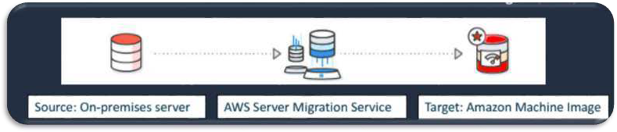
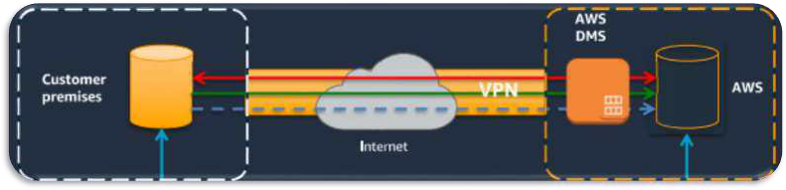
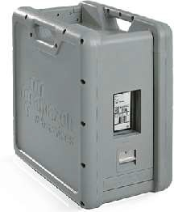
Tools for Migrations
Server Migration Service
VMware
AWS
Database Migration Service
Source DB
Target DB
Offline transfer
Size: 50TB, 80TB, 100TB.
Time to transfer in low bandwidth uplinks.
Snowball

Slide 67

The Six R’s of Application Migration
Pattern Label
Pattern Name
Pattern Percentage
R1
Retain
10%
R2
Retire
(Decommission)
5%
R3
Re-Host
(Lift and Shift)
40%
70%
R4
Re-Platform
(Lift and Replace)
30%
R5
Re-Factor
(Rewriting and Decoupling Applications)
10%
R6
Re-Purchase
(Replace/Drop and Shop)
5%

Slide 68
Module 6: Pricing Solutions and TCO on AWS

Slide 69



AWS Pricing Philosophy
01
02
03
Pay Only for What You Use
Low Cost
No Up-Front Capital Expense

Slide 70
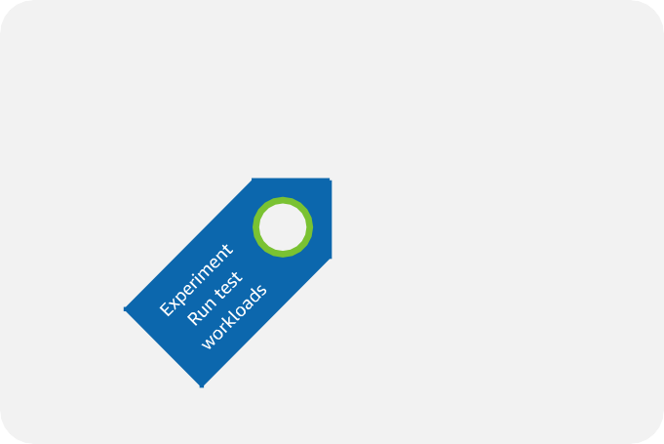

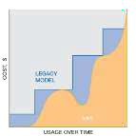
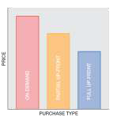

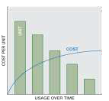




AWS Pricing Categories
AWS Free Tier
Pay as You Go
Pay Less When You Reserve
Pay Even Less per Unit by Using More
Pay Even Less as AWS Grows and Lowers Prices
Additional AWS Pricing Benefits

Slide 71

Amazon EC2 Instance Types
R3 _{M4}
General Purpose
Compute Optimized
Memory Optimized
M3
R4 C4
T2
X1
Accelerated Computing
Storage Optimized
C3
P2

Slide 72





On-Demand and Reserved
Instance Type
Benefits
When to Position
Workloads
On-Demand
Billing by the second
(new as of 10/2/17)
Customer seeking to avoid long contracts and upfront payments
Short-Term/Fluctuates
Desired to Run to Completion Dev/Test
Modify compute capacity
Reserved
50%-70% less than On- Demand instances
Customer able to commit to 1year ~ 3 year term
Steady-state applications

Slide 73

Spot Instances
Instance Type
Benefits
When to Position
Workloads
Spot Fleet
Discounts compared to on-demand pricing
When workloads can continue after interruptions; for diversification across multiple instance types and AZs
Batch processing, Hadoop workflow, HPC grid
Spot Block
Run continuously for
a set duration at lower pricing
When workloads cannot be interrupted for a set duration
Encoding, rendering, modeling, analysis, or continuous integration
Spot Bid Advisor
Helps determine best bid price

Slide 74
Dedicated Instances and Dedicated Hosts
Instance Type
Benefits
When to Position
Workloads
Dedicated Instance
Instances run on hardware dedicated to you only
For workloads that require dedicated hardware to meet unique security and compliance needs
Data isolation required
Customer must pay an hourly instance fee
Customer must pay a dedicated per region fee
Dedicated Host
Instances run on hardware dedicated to you only
License portability
Fine grain control of hardware
For existing server-bound software licenses that are bound to VMs, sockets, or physical cores
Data isolation required License dependent applications or services

Slide 75



Dedicated Instance vs. Dedicated Host
Dedicated Instance
Dedicated Host
2.3 GHZ CPU
2.4 GHZ CPU
2.35 GHZ CPU
2.8 GHZ CPU
Dedicated Instance
Can reinitiate on any hardware in data center
Dedicated Host
EC2 Instance remains on same dedicated hardware permanently
Hardware still dedicated to your AWS account
Physical hardware your EC2 Instance runs on may not be the same

Slide 76


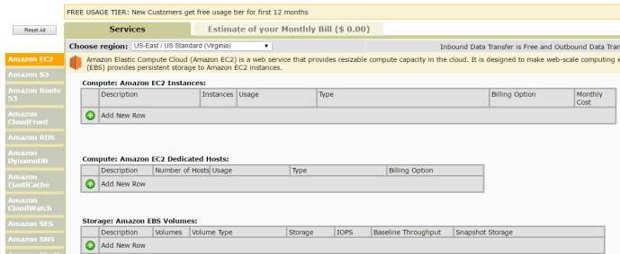
Estimating Cost Savings: Simple Monthly Calculator
Video: https://www.youtube.com/ watch?v=54TVCueOoAc
In Class Demonstration:
http://bit.ly/2t3535R

Slide 77
Total Cost of Ownership

Slide 78
How Do Customers Lower Their TCO With AWS?
01
02
03
04
Dynamic Usage with Increased Utilization
Pass Through Economies of scale
Pricing model choice
Save as you grow
Better use of computational power
68 Price Reductions
since 2006
Spot Reserved On-Demand Dedicated
Tiered Pricing Volume Discounts

Slide 79
Costs Involved in Data Center Maintenance
Hardware:
server, rack, chassis PDUs,
TOR switches (+maintenance)
Software:
OS, virtualization, licenses
(+maintenance)
Facilities cost
01
Server costs
Space | Power | Cooling
Hardware: storage disks, SAN/FC switches
Storage:
admin costs
Facilities cost
02
Storage costs
Space | Power | Cooling
Network hardware:
LAN, switches, load balancer,
bandwidth costs
Network:
admin costs
Facilities cost
03
Network costs
Space | Power | Cooling
04
IT labor costs
Server admin

Slide 80

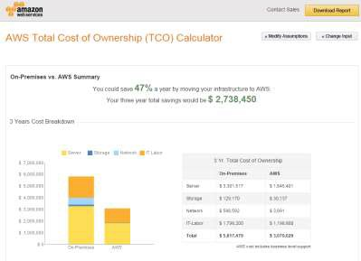

TCO Calculators
Estimate Savings
Reports
https://awstcocalculator.com/
AWS TCO Calculator: Application cost on-premises vs. AWS
AWS Backup and Archive TCO Calculator: Backup and archive costs on-premises vs. AWS

Slide 81
Your TCO Reduction Opportunity with the Customer
APN
Partner Benefits
Payback
Period
Cost
Migration Period
Customer Benefits
Current/Do Nothing
Post-Migration Initial State
AWS Environment
Cost Optimising / BAU Repurposing
On-Prem Assets
Time

Slide 82
Module 7 : Conclusion

Slide 83



APN Resources
APN Program Guide
Monthly Partner-Facing
Webinars
APN Personnel Resources
Benefits and Requirements
Training and
Certification
APN Blog, Newsletter, Twitter
APN Portal
Marketing
https://partnercentral.awspartner.com
I
APN Partner Programs

Slide 84
Partner Training – Digital Learning Platform
AWS Digital Learning Platform
https://www.aws.training/
Workshops and Bootcamps
Videos, Labs, and Classes
Specialty Courses for APN Partners With Business and Technical Tracks
Accreditations
Business Track
Technical Track
AWS Business Professional AWS TCO and Cloud Economics AWS Foundations
Big Data and Analytics on AWS Windows on AWS
Migration to AWS
SAP on AWS
Amazon Connect
Introduction to Cloud Adoption Framework
AWS Technical Professional AWS TCO and Cloud Economics Well-Architected Framework Windows on AWS
Migration to AWS SAP on AWS
Amazon Connect
Professional Services BootCamp
https://partnercentral.awspartner.com

Slide 85
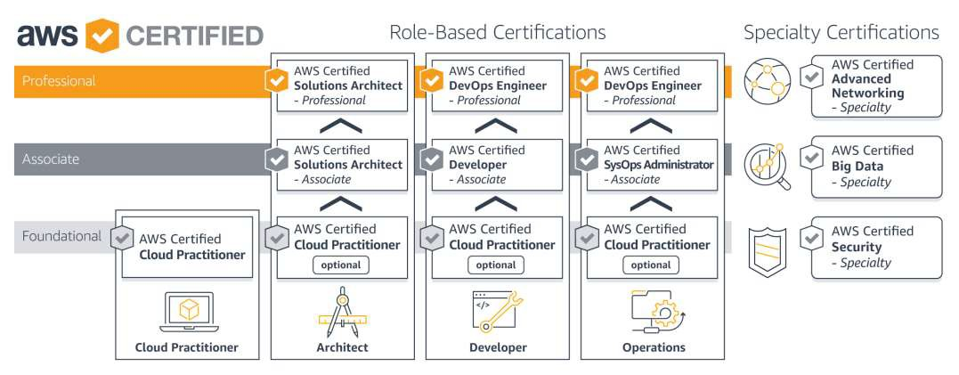
AWS Certification
https://youtu.be/WqUQNp1hAH8

Slide 86
Class Completion
Satyanarayana Sure
AppOps
THANK
YOU!

